Slide 1



Operating System
Prof. Sumitra Menaria, Prof. Uma Bhatt, Assistant Professor Information Technology Department

Slide 2

Thread
A thread is a single sequence stream within a process.
They are sometimes called lightweight processes.
In a process, threads allow multiple executions of streams.
Thread is an execution unit which consists of its own program counter, a stack, and a set of registers.
As each thread has its own independent resource for process execution, multiple processes can be executed parallel by increasing number of threads.
Each thread belongs to exactly one process and no thread can exist outside a process.

Slide 3
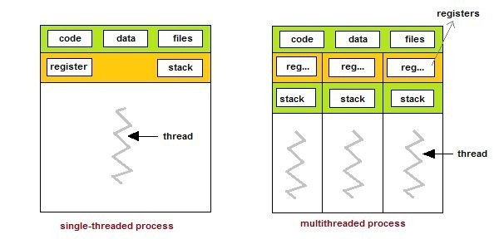
Threads
Single and Multithreaded Processes ^{[1]}

Slide 4
Advantages of Thread
Threads minimize the context switching time.
Use of threads provides concurrency within a process.
Efficient communication.
It is more economical to create and context switch threads.
Threads allow utilization of multiprocessor architectures to a greater scale and efficiency.

Slide 5
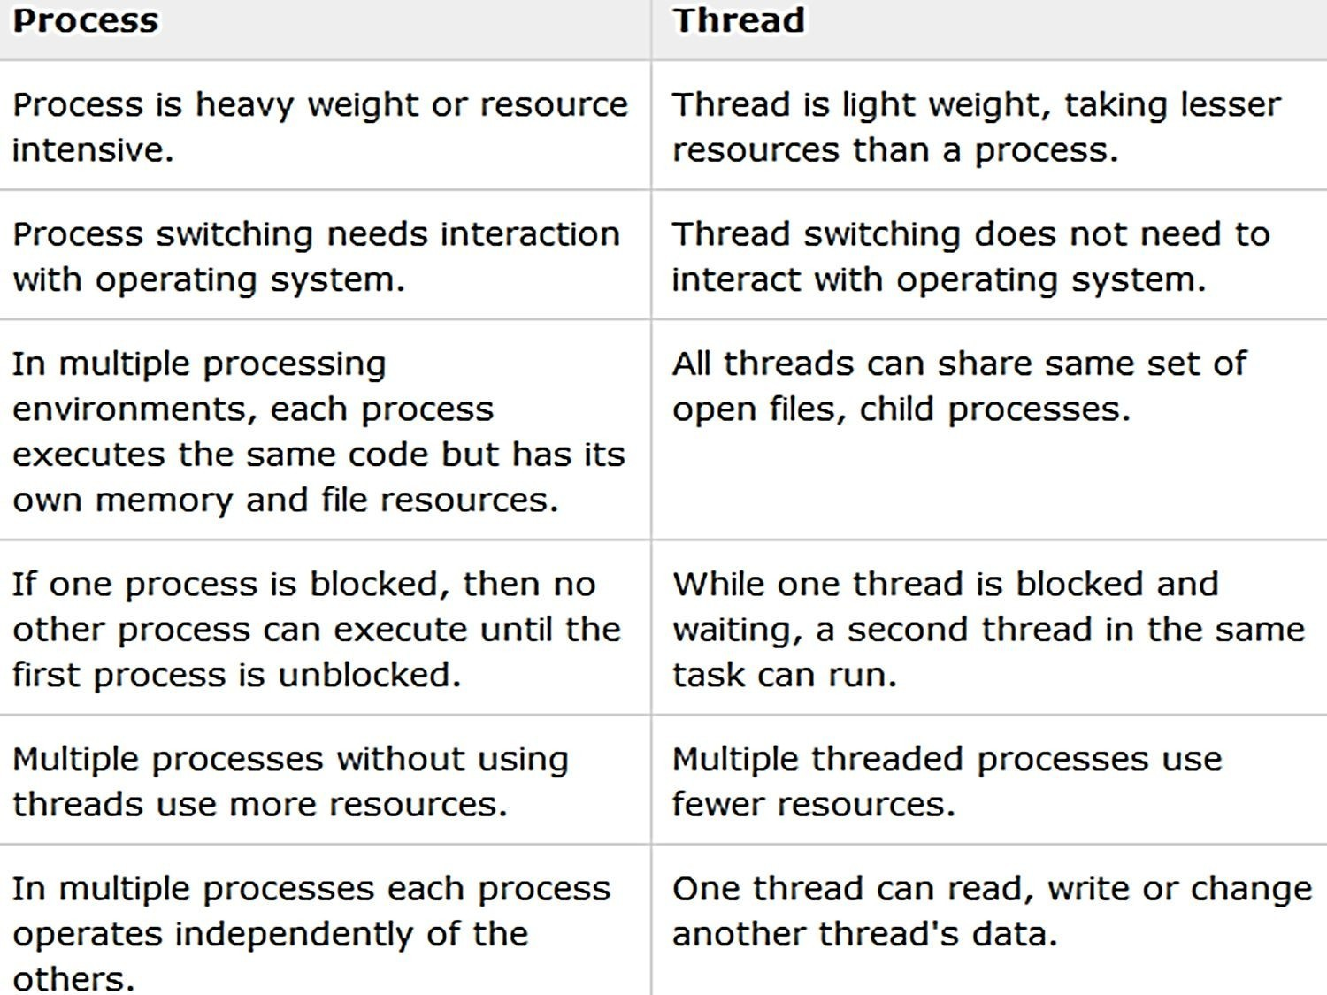
Process Vs. Thread

Slide 6
Types of Thread
User Level Threads − User managed threads.
Kernel Level Threads − Operating System managed threads acting on kernel, an operating system core.

Slide 7
User Level Thread
•
In this case, the thread management kernel is not aware of the existence of threads.
•
The thread library contains code for creating and destroying
threads, for passing message and data between threads, for scheduling thread execution and for saving and restoring thread contexts.
•
The application starts with a single thread.

Slide 8
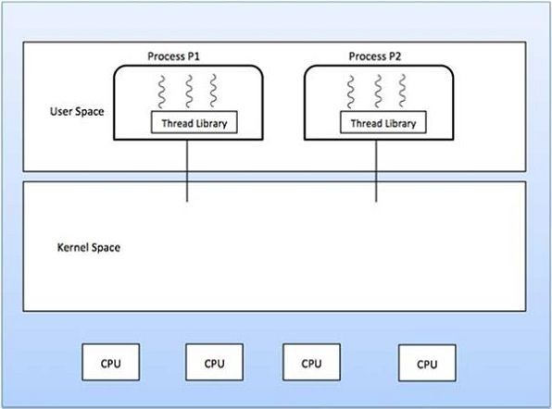
Contd…
User Level Thread :Google

Slide 9
Advantages and Disadvantages
Advantages
•
•
•
•
Thread switching does not require Kernel mode privileges. User level thread can run on any operating system.
Scheduling can be application specific in the user level thread. User level threads are fast to create and manage.
Disadvantages
Multithreaded application cannot take advantage of multiprocessing

Slide 10
Kernel Level Thread
In this case, thread management is done by the Kernel.
There is no thread management code in the application area.
Kernel threads are supported directly by the operating system.
The Kernel performs thread creation, scheduling and management in Kernel space.

Slide 11
Advantages
Kernel can simultaneously schedule multiple threads from the same process on multiple processes.
If one thread in a process is blocked, the Kernel can schedule another thread of the same process.

Slide 12
Disadvantages
Kernel threads are generally slower to create and manage than the user threads.
Transfer of control from one thread to another within the same process requires a mode switch to the Kernel.

Slide 13

Multithreading
Ability of operating system to execute multiple threads.
Some operating system provide a combined user level thread and Kernel level thread facility.
Multithreading Models
Many to One Model
One to One Model
Many to Many Model

Slide 14
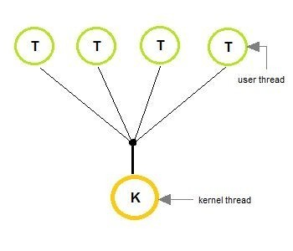
Many to one Model
In the many to one model, many user-level threads are all mapped onto a single kernel thread.
Thread management is handled by the thread library in user space, which is efficient in nature
.
Many to One Model ^{[1]}

Slide 15
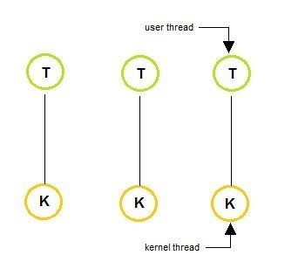
One to One Model
The one to one model creates a separate kernel thread to handle each and every user thread.
Most implementations of this model place a limit on how many threads can be created.
Linux and Windows from 95 to XP implement the one-to-one model for threads
One to One Model ^{[1]}

Slide 16
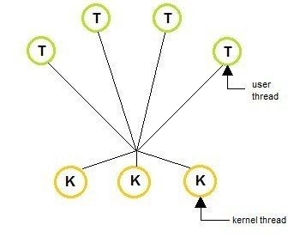
Many to Many Model
The many to many model multiplexes any number of user threads onto an equal or smaller number of kernel threads, combining the best features
of the one-to-one and many-to-one models.
Users can create any number of the threads.
Blocking the kernel system calls does not block the entire process.
Processes can be split across multiple processors.
Many to Many Model^{[1]}

Slide 17
Benefits of Multithreading
Responsiveness
Resource sharing, hence allowing better utilization of resources.
Economy: Creating and managing threads becomes easier.
Scalability: One thread runs on one CPU. In Multithreaded processes, threads can be distributed over a series of processors to scale.
Context Switching is smooth. Context switching refers to the procedure followed by CPU to change from one task to another.

Slide 18
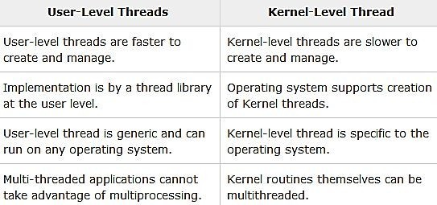
User Level Thread Vs. Kernel Level Thread

Slide 19


www.paruluniversity.ac.in

